Slide 1

Indigo3D
Product Launch
Released on 12/6/2018

Slide 2
contents
1
2
3
4
5
Demand Analysis
System Design
Testing
System Development
ITS

Slide 3
1
Demand Analysis

Slide 4
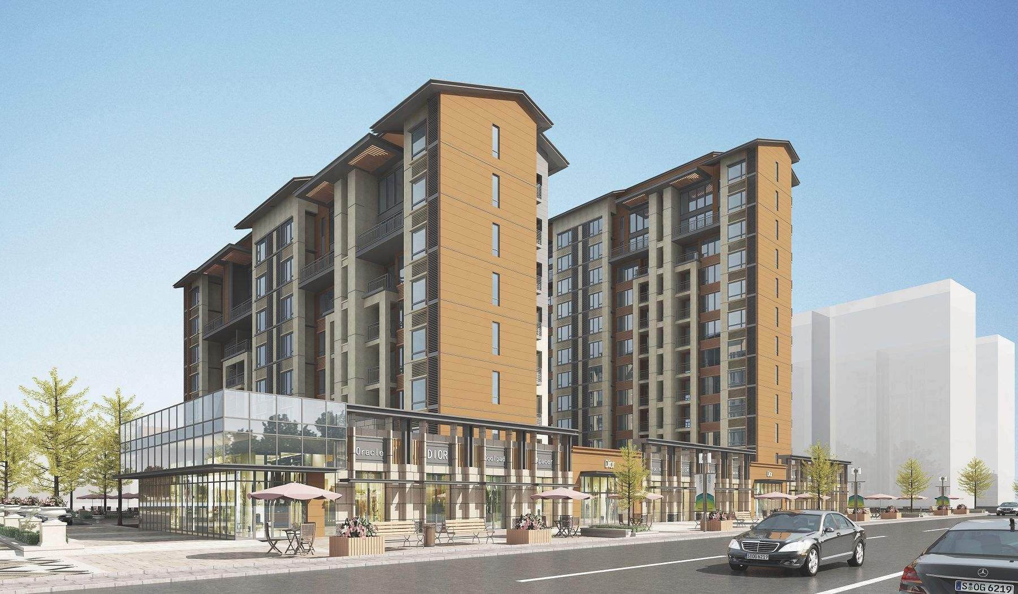

Demand Analysis
2D 3D
Higher Accuracy
Construction Industry

Slide 5
2
System Design

Slide 6

2.0 Module division
User
Interaction
01
03
Scene
Rendering
Scene
Drawing
02

Slide 7
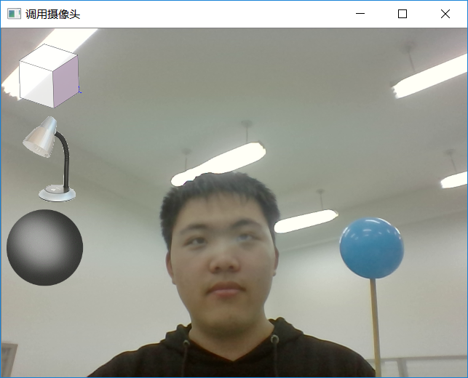


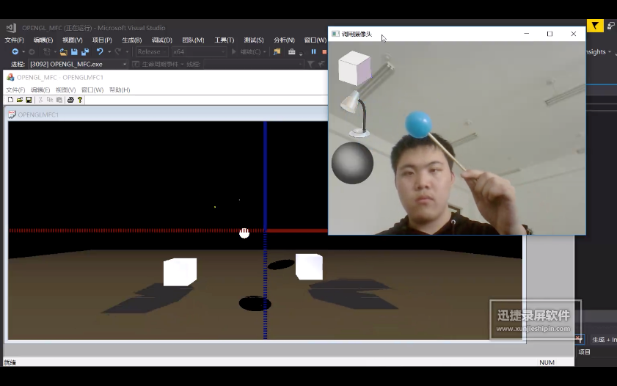


2.1 User Interaction Module
01
Camera Invoking
02
标题内容
Recognition
03
04
&
Real-time 3D operation
Further precise
Operation

Slide 8
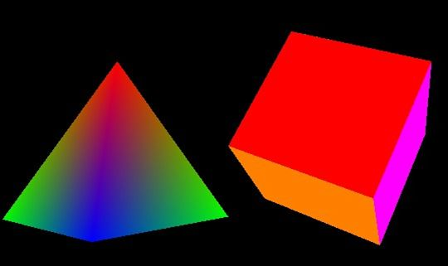
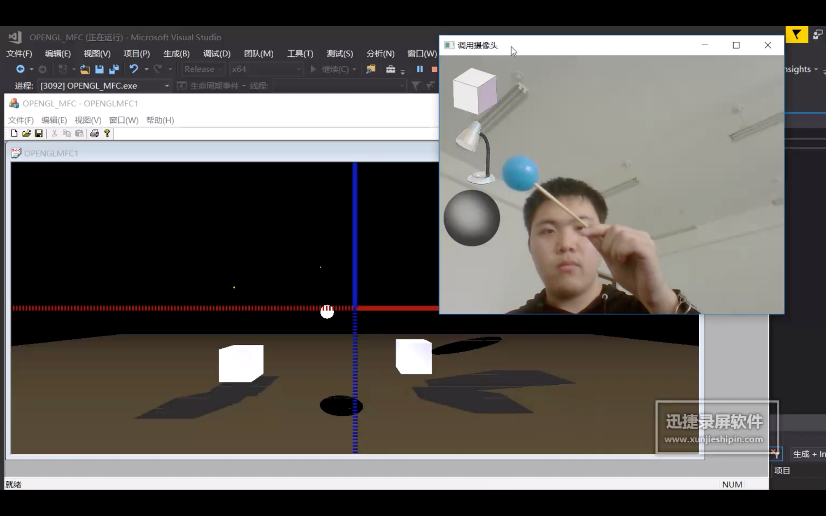
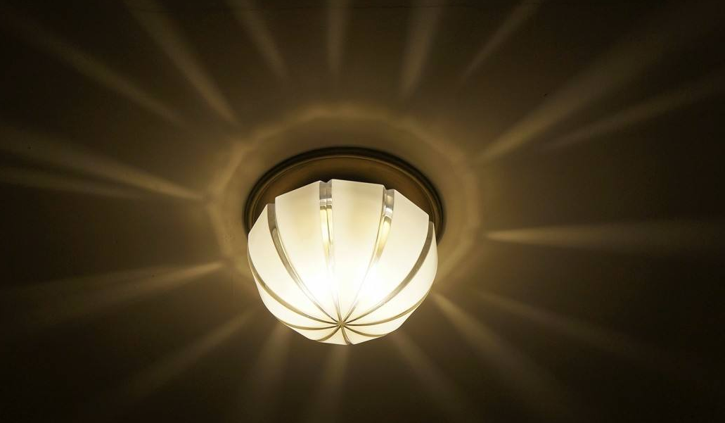
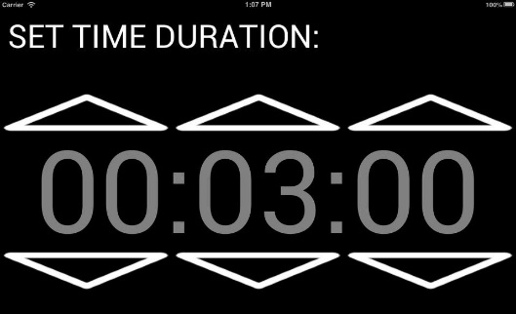
2.2 Scene Drawing Module
Draw 3D vector graphics
Draw Lighting and shadow
OpenGL
Set timer to refresh the scene dynamically
Scene

Slide 9
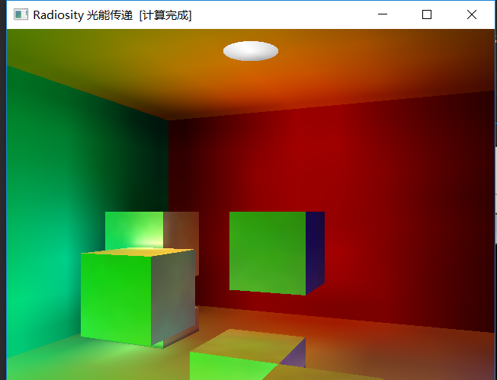
2.3 Scene Rendering Module
01
Based on radiancy technology
02
Simulate light propagation
标题内容
03
Calculate light distribution
on the surface
您的内容打在这里，或者通过复制您的文本后，在此框中选择粘贴，并选择只保留文字。
您的内容打在这里，或者通过复制您的文本后，在此框中选择粘贴，并选择只保留文字。
04
Adjust visual angel and
parameters of hue

Slide 10
3
Testing

Slide 11

3.0 Testing
Indigo Identification
.
.
.
Software Testing
Shadow rendering

Slide 12
System Development
4

Slide 13
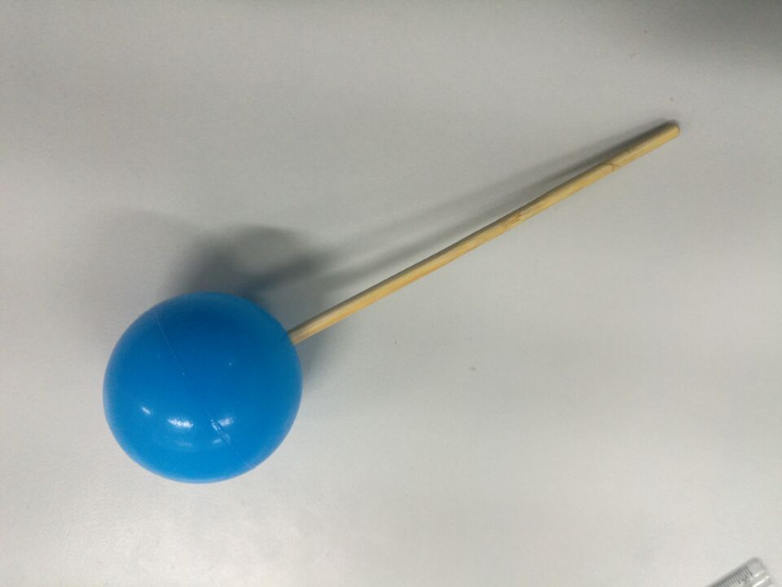
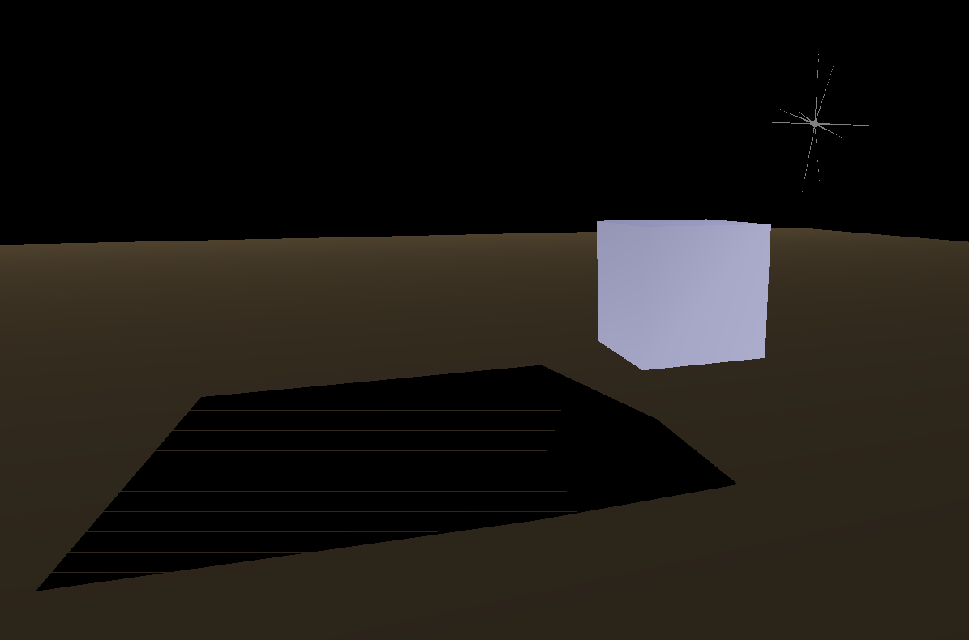
4.0 Core algorithm
Indigo Identification
Shadow rendering

Slide 14
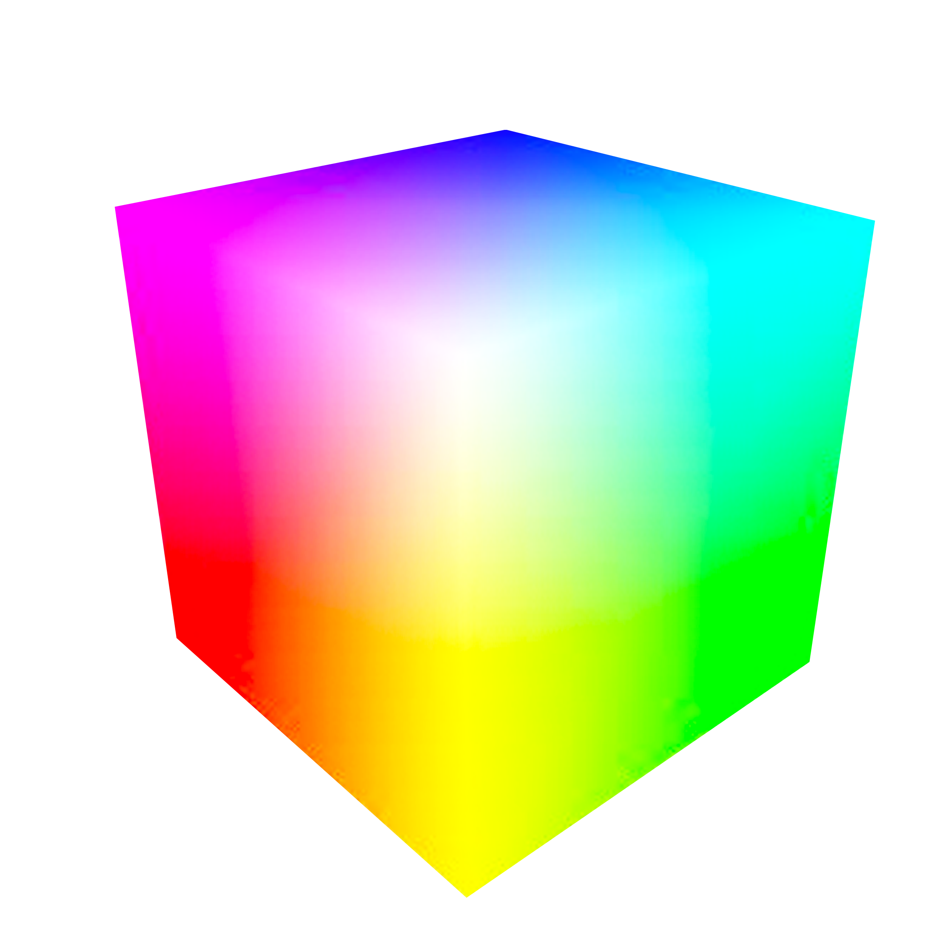

4.1 Indigo identification
f()=?*b+?*g+?*r
f()=8*b-g-12*r
b
Blue√
>100?
1. Function design
Presentation in Color Cube
Design a function to identify the degree to which a pixel is blue, in the form of: (color value of pixel is (colorb,colorg,colora), then f()=a*colorb+b*colorg+c*colorr,a,b,c are undetermined coefficients), and the empirical value obtained by repeated tests in various environments is as follows: (f()=8*colorb-1*colorg-12*colorr), with a threshold of 100. When f() is greater than that it identifies a blue point and marks it as a yellow point.
r
g
Blue×
Color Cube

Slide 15

4.1 Indigo identification
2. Review Process
Enhance accurate
Blue
Relax the f() condition for the points adjacent to the identified points, and iterate the process a to ensure that each blue point with small blue can be recognized.

Slide 16
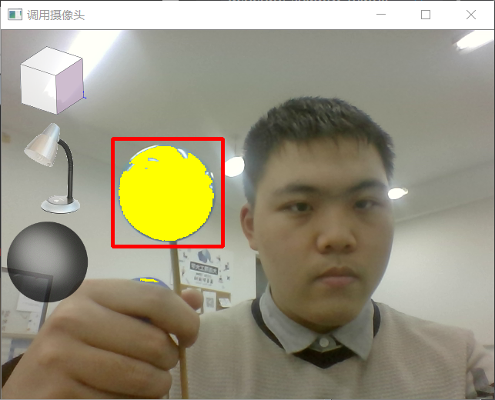
4.1 Indigo identification
3. Make Redbox
Scope clarification
According to the location of the blue points, the identified blue points are narrowed in scope (red box). Each time the number of blue points detected outside the scope is narrowed, if the number is greater than a certain threshold, the loop will be broken out, with the purpose of excluding miscellaneous points outside the scope
in box?×

Slide 17
4.1 Indigo identification
X
4. Calculate position
Make out (x,y,z)
number
of points
Z
Y
Calculate the mean value of x and y of identified points and the number of points within the calibration range, make a mapping based on these three parameters and the current position of the opengl camera, and figure out the corresponding x,y and z coordinates in the opengl scene

Slide 18
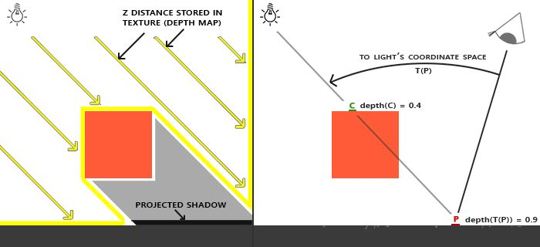

4.2 Shadow rendering
1.Location determination
Obtain the position of light source and the equation of projective surface
2. Mapping rule calculation
Calculate a mapping rule for the position of each light source point. Each rule is stored in the form of a 4*4 matrix.

Slide 19
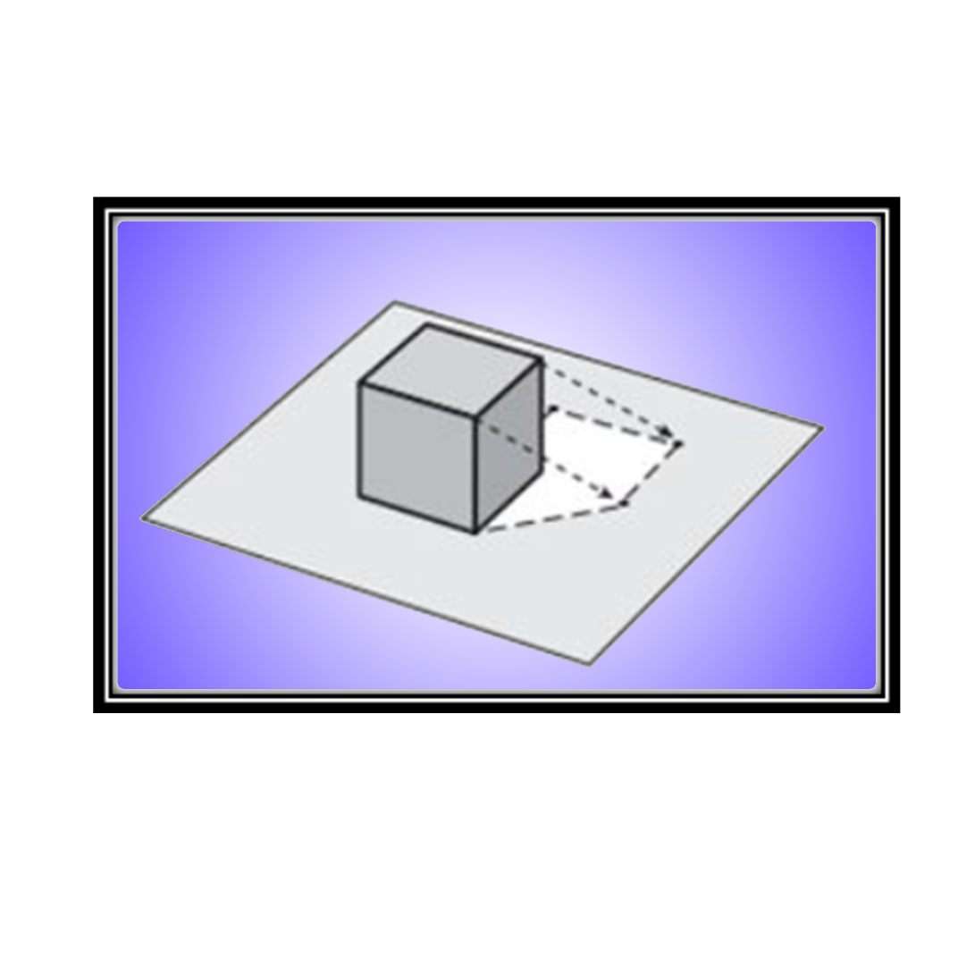
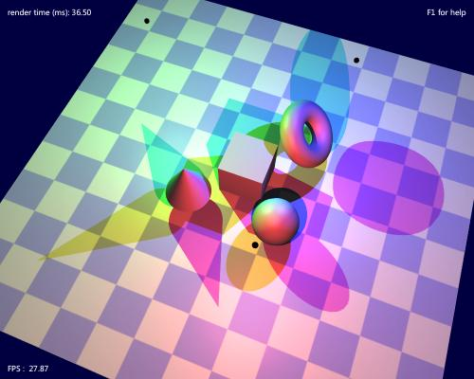
4.2 Shadow rendering
4. Draw shadows
Draw a 2D pattern composed of these point sets in gray to complete the drawing of shadows.
3. Mapping objects
Map each object in the scene

Slide 20
Issue Tracking System
5

Slide 21
5.1 ITS
Defect No. | Date Created | Created By | Defect Description | PM process | Life Cycle Phase | Priority | Owner | Resolution
1 | 11/29/18 | ZJZ | At runtime, OpenCV pops out of two windows in release/x64. | Initiating | Development | L | ZJZ | Still in status.
2 | 12/01/18 | ZRK | Program stuck. Real-time operation is inconsistent. | Executing | Testing | M | ZJZ | Improve algorithms, use OpenCV built-in functions.
3 | 12/02/18 | LHM | Simple shadow colors are different in the program. | Executing | Design | L | ZJZ | Uniform color values, all in black.
4 | 12/02/18 | LHM | Light source is not easy to be found during operation. | Executing | Requirement | M | ZJZ | Change it to the star shape.
5 | 12/03/18 | ZRK | When light is removed, the ground color doesn’t darken accordingly. | Executing | Testing | L | ZJZ | Still in status.
Speed improvement
Problem
Description
Problem Analysis
Problem Solution

Slide 22
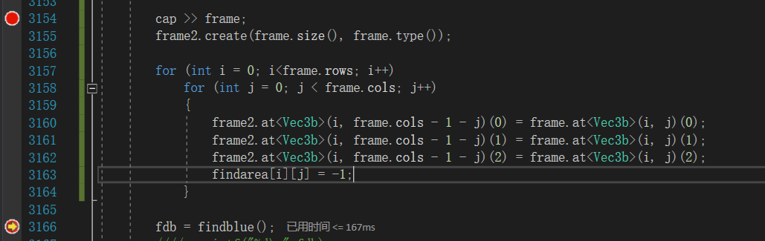

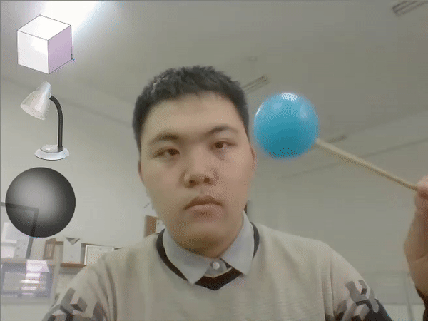
5.2 Speed Problems (ITS)
Simplify?
flip()
60 %
167ms
button()
5 %
13ms
findblue()
31 %
87ms
imshow()
4 %
10ms

Slide 23
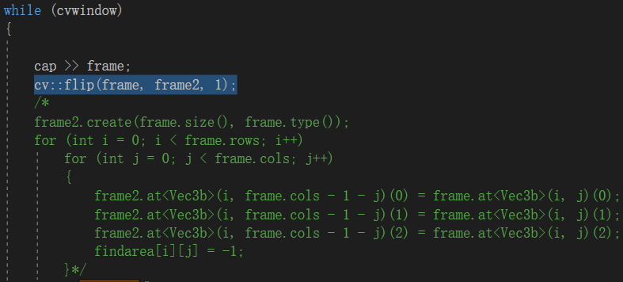
5.3 Problem Analysis (ITS)
Calculate as a whole
Executing more than one statement can slow things down. Perform a global operation to reduce the number of statements executed
Prejudgment
When the operation is too complicated, we can predict the result. If the pre-judgment is beyond the expected range, the post-judgment process can be jumped out directly.
Using built-in functions
Developers of OpenCV libraries must figure out how to lighten the program burden. So why don't we use the functions they write?

Slide 24
5.4 Problem Solution (ITS)
Total
91ms
277ms
Flip()
button()
167ms
8ms
13ms
<1ms
findblue()
imshow()
73ms
87ms
10ms
95 %

Slide 25
6
Product display

Slide 26
Thank you
Q&A

